Slide 1
Multiple Regression

Slide 2
The Multiple Regression Model
Use multiple regression to describe the relationship between several explanatory variables and the response.
Multiple regression separates the effects of each explanatory variable on the response and reveals which really matter.

Slide 3
The Multiple Regression Model
Multiple regression model (MRM): model for the association in the population between multiple explanatory variables and a response.
k: the number of explanatory variables in the multiple regression (k = 1 in simple regression).

Slide 4
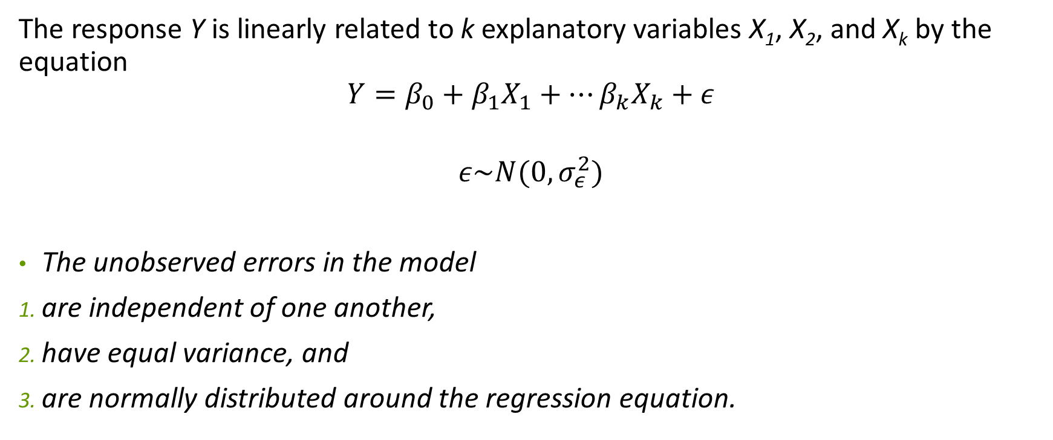
The Multiple Regression Model
The response Y is linearly related to k explanatory variables X₁, X₂, and X_{k} by the equation
$$Y=β_{0}+β_{1}X_{1}+…β_{k}X_{k}+ε$$
$$ε\sim N(0, σ_{ε}^{2})$$
The unobserved errors in the model
are independent of one another,
have equal variance, and
are normally distributed around the regression equation.

Slide 5
The Multiple Regression Model
While the SRM bundles all but one explanatory variable into the error term, multiple regression allows for the inclusion of several variables in the model.
In the MRM, residuals departing from normality may suggest that an important explanatory variable has been omitted.

Slide 6
Interpreting Multiple Regression
Example: Estimating the price of a house
Response variable: Price of the house (INR).
Three explanatory variables: Size of the house (in square foot), number of bedrooms and the number of parking lots provided.

Slide 7
Interpreting Multiple Regression
Correlation Matrix: Price of the house
 | Area | Bedrooms | Parking | Price
Area | 1 | 0.6 | 0.41 | 0.50
Bedrooms |  | 1 | 0.289 | 0.56
Parking |  |  | 1 | 0.45
Price |  |  |  | 1

Slide 8
Interpreting Multiple Regression
R-squared and s_{e}
R² indicates that the fitted equation explains % of the variation in price.
For this example, s_{e} = .

Slide 9
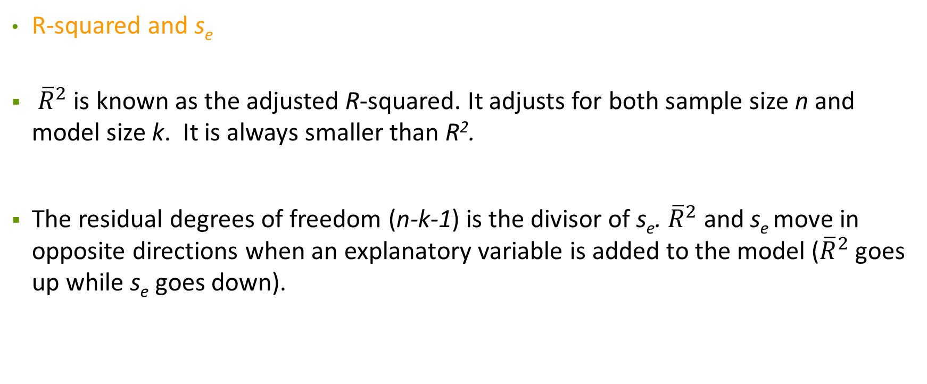
Interpreting Multiple Regression
R-squared and s_{e}
${\overline{R}}^{2}$ is known as the adjusted R-squared. It adjusts for both sample size n and model size k. It is always smaller than R².
The residual degrees of freedom (n-k-1) is the divisor of s_{e}. ${\overline{R}}^{2}$ and s_{e} move in opposite directions when an explanatory variable is added to the model (${\overline{R}}^{2}$ goes up while s_{e} goes down).

Slide 10
Interpreting Multiple Regression
Calibration Plot
Calibration plot: scatterplot of the response on the fitted values .
R² is the correlation between and ; the tighter data cluster along the diagonal line in the calibration plot, the larger the R² value.

Slide 11
Interpreting Multiple Regression
Marginal and Partial Slopes
Partial slope: slope of an explanatory variable in a multiple regression that statistically excludes the effects of other explanatory variables.
Marginal slope: slope of an explanatory variable in a simple regression.

Slide 12
Interpreting Multiple Regression
Marginal and Partial Slopes
Partial and marginal slopes only agree when the explanatory variables are uncorrelated.
In this example they do not agree. For instance, the marginal slope for Competitors is The MRM separates these effects but the SRM does not.

Slide 13
Interpreting Multiple Regression
Path Diagram
Path diagram: schematic drawing of the relationships among the explanatory variables and the response.
Collinearity: very high correlations among the explanatory variables that make the estimates in multiple regression uninterpretable.

Slide 14
Checking Conditions
Conditions for Inference
Use the residuals from the fitted MRM to check that the errors in the model
are independent;
have equal variance; and
follow a normal distribution.

Slide 15

Inference in Multiple Regression
Inference for the Model: F-test
The F-Statistic
is used to test the null hypothesis that all slopes are equal to zero,
$$H_{0}:β_{1}=β_{2}=0$$

Slide 16
Inference in Multiple Regression
Inference for One Coefficient
The t-statistic is used to test each slope using the null hypothesis H₀: β_{j} = 0.
The t-statistic is calculated as

Slide 17

Inference in Multiple Regression
Prediction Intervals
An approximate 95% prediction interval is given by $\hat{y}±2s_{e}$.
For example, the 95% prediction interval for price.

Slide 18
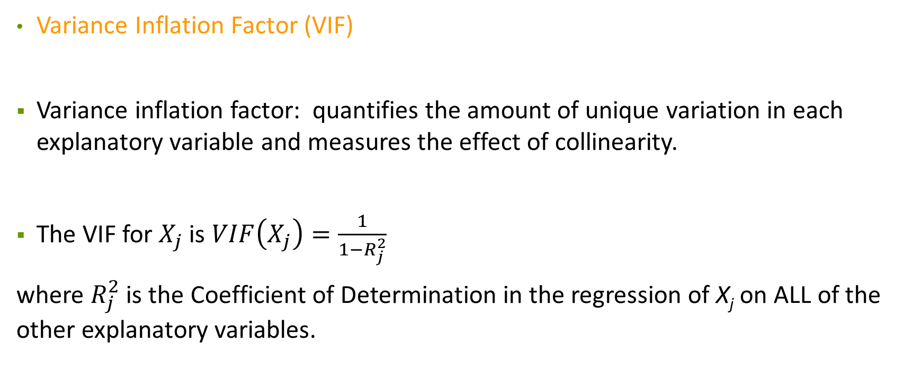
Collinearity
Variance Inflation Factor (VIF)
Variance inflation factor: quantifies the amount of unique variation in each explanatory variable and measures the effect of collinearity.
The VIF for $X_{j}$ is $VIF\left(X_{j}\right)=\frac{1}{1−R_{j}^{2}}$
where $R_{j}^{2}$ is the Coefficient of Determination in the regression of X_{j} on ALL of the other explanatory variables.

Slide 19

Why does VIF matter?
The standard error in estimation of the partial slope gets inflated due to VIF.
Typically,
$$se\left(b_{1}\right)=\frac{s_{e}}{\sqrt{n}}×\frac{1}{s_{x}}$$
With VIF
$$se\left(b_{1}\right)=\frac{s_{e}}{\sqrt{n}}×\frac{1}{s_{x}}×\sqrt{VIF(X_{1})}$$

Slide 20
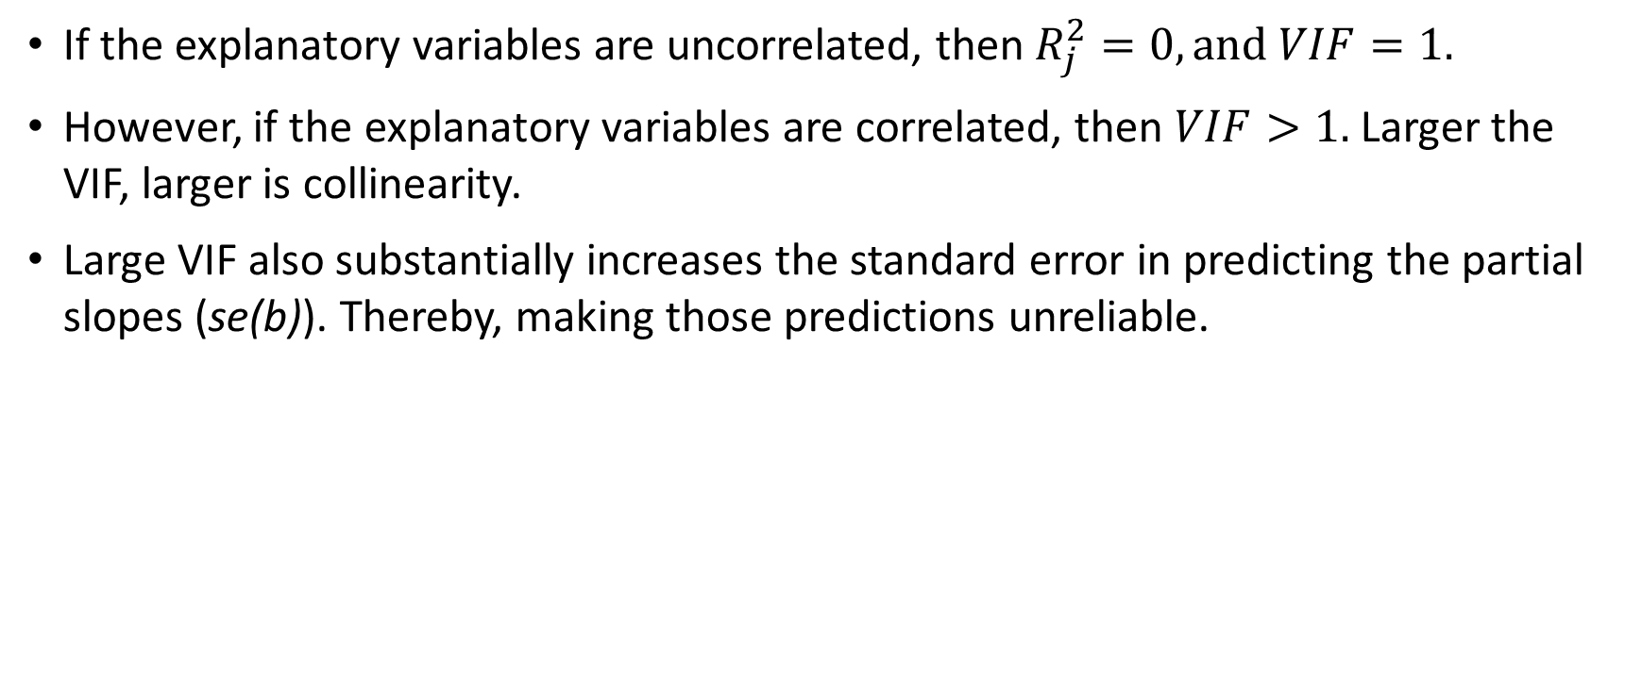
VIF
If the explanatory variables are uncorrelated, then $R_{j}^{2}=0, and VIF=1.$
However, if the explanatory variables are correlated, then $VIF>1.$Larger the VIF, larger is collinearity.
Large VIF also substantially increases the standard error in predicting the partial slopes (se(b)). Thereby, making those predictions unreliable.

Slide 21
Collinearity
Results for VIF

Slide 22
VIF
From our example, the explanatory variables in the MLR are turning to be insignificant.
The explanatory variables aren’t significant once we have taken account of the other explanatory variables.

Slide 23
Collinearity
Signs of Collinearity
R² increases less than we’d expect.
Slopes of correlated explanatory variables in the model change dramatically.
The F-statistic is more impressive than individual t-statistics.
Standard errors for partial slopes are larger than those for marginal slopes.
Variance inflation factors increase.

Slide 24
Collinearity
Remedies for Collinearity
Remove redundant explanatory variables.
Re-express explanatory variables (e.g., use the average of Market % Change and Dow % Change as an explanatory variable).
Do nothing if the explanatory variables are significant with sensible estimates.

Slide 25
Removing Explanatory Variables
Issues
After adding several explanatory variables to a model, some of those added and some of those originally present may not be statistically significant.
Remove those variables for which both statistics and substance indicate removal (e.g., remove Dow % Change rather than Market % Change).

